Slide 1
VA-NJ-CT Plans
GOLDILOCKS & The Constitution

Slide 2
VIRGINIA PLAN
3 Branches
Bi-Cameral Congress
Representation based on population or amount of money given to Federal Gov’t

Slide 3
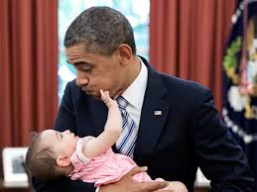
New Jersey Plan
Unicameral Congress
Equal representation
Much more limited Federal Gov’t (amend Articles of Confederation)
More than one federal executive

Slide 4
The Great Compromise AKA: Connecticut Compromise
Bi Cameral (Upper & Lower House)
Senate (2 per state)
House (by population)
Today? # of Senators= # of Reps= Total:
----------------------------------------------------------------------------------
What about slaves……???
Three-Fifths Compromise (sad but true)

