Slide 1
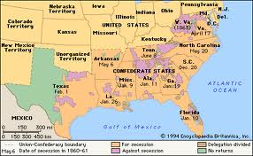
Secession
1860-61

Slide 2
Secession
Means to withdraw membership from
In this case, states were withdrawing from the US
South Carolina was the first (Dec 1860)
6 others, the “Deep South” soon followed (Jan-Feb 1861)

Slide 3
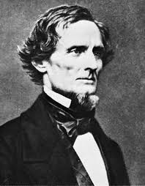
Secession
Last straw was Lincoln’s election
Named the Confederate States of America (Jefferson Davis- President)

Slide 4
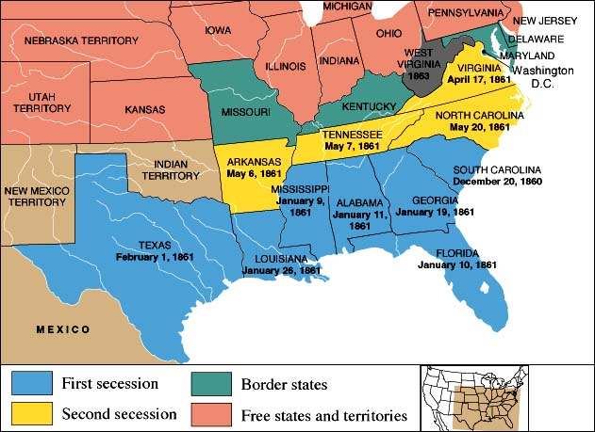

Slide 5
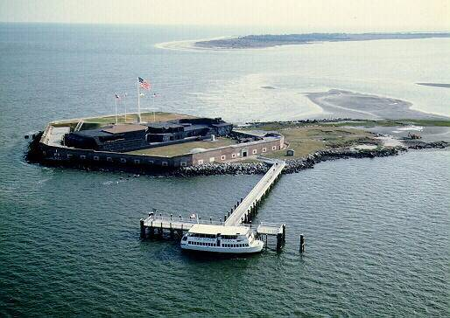
Fort Sumter

Slide 6
Fort Sumter
US Military Fort in South Carolina
Why did the South not want it there? (think about secession)
The battle for Fort Sumter lasted a little over a day
The US Military gives up the Fort to the South

Slide 7
Fort Sumter
After this, 4 more Southern states secede
Why did they wait until after Fort Sumter?
Map on page 82
With a partner create a list of difficulties the South faced when trying to create its own country.

