Slide 1
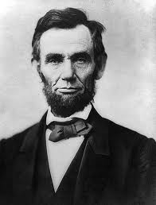
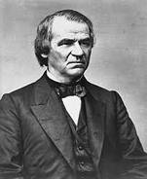
Presidential Reconstruction

Slide 2
Partner Think Tank
1) Who would direct the process of Reconstruction? The South itself, Congress, or the President?

Slide 3
2) Should the Confederate leaders be tried for treason?

Slide 4
3) How would the south, both physically and economically devastated, be rebuilt? And at whose expense?

Slide 5
4) How would the south be readmitted and reintegrated into the Union?

Slide 6
5) What should be done with over four million freed slaves? Were they to be given land, social equality, education, and voting rights?

Slide 7
Lincoln’s Plan
Partner A: 4 Pros and 3 Cons

Slide 8
Johnson’s Plan
Partner B: 4 Pros and 3 Cons

