Slide 1
ORIGINS OF STATE
(Not the 50)

Slide 2
Definition
Population, territory, sovereignty, government
Draw the UNITED STATES “STATE” below

Slide 3
Origins (4 Theories)
Force
Evolutionary
Divine Right
Social Contract

Slide 4
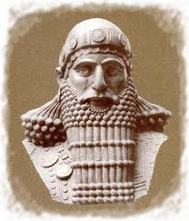
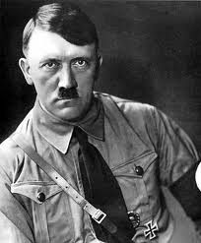
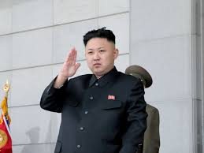
FORCE! Theory
One person or one group claimed control

Slide 5
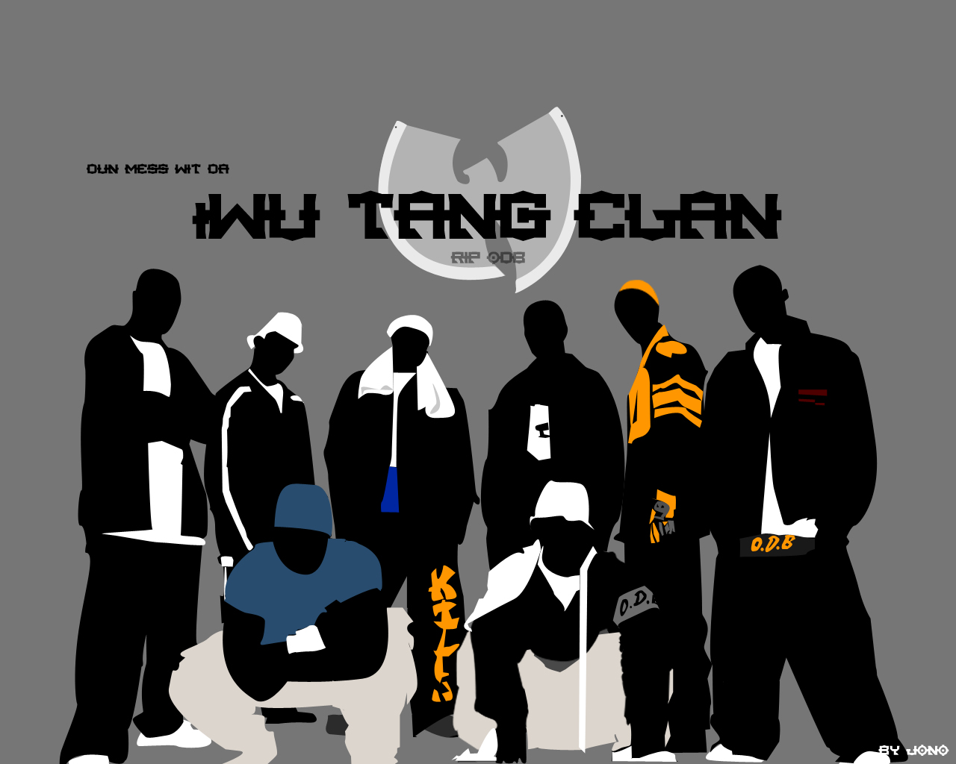
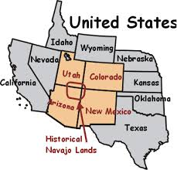
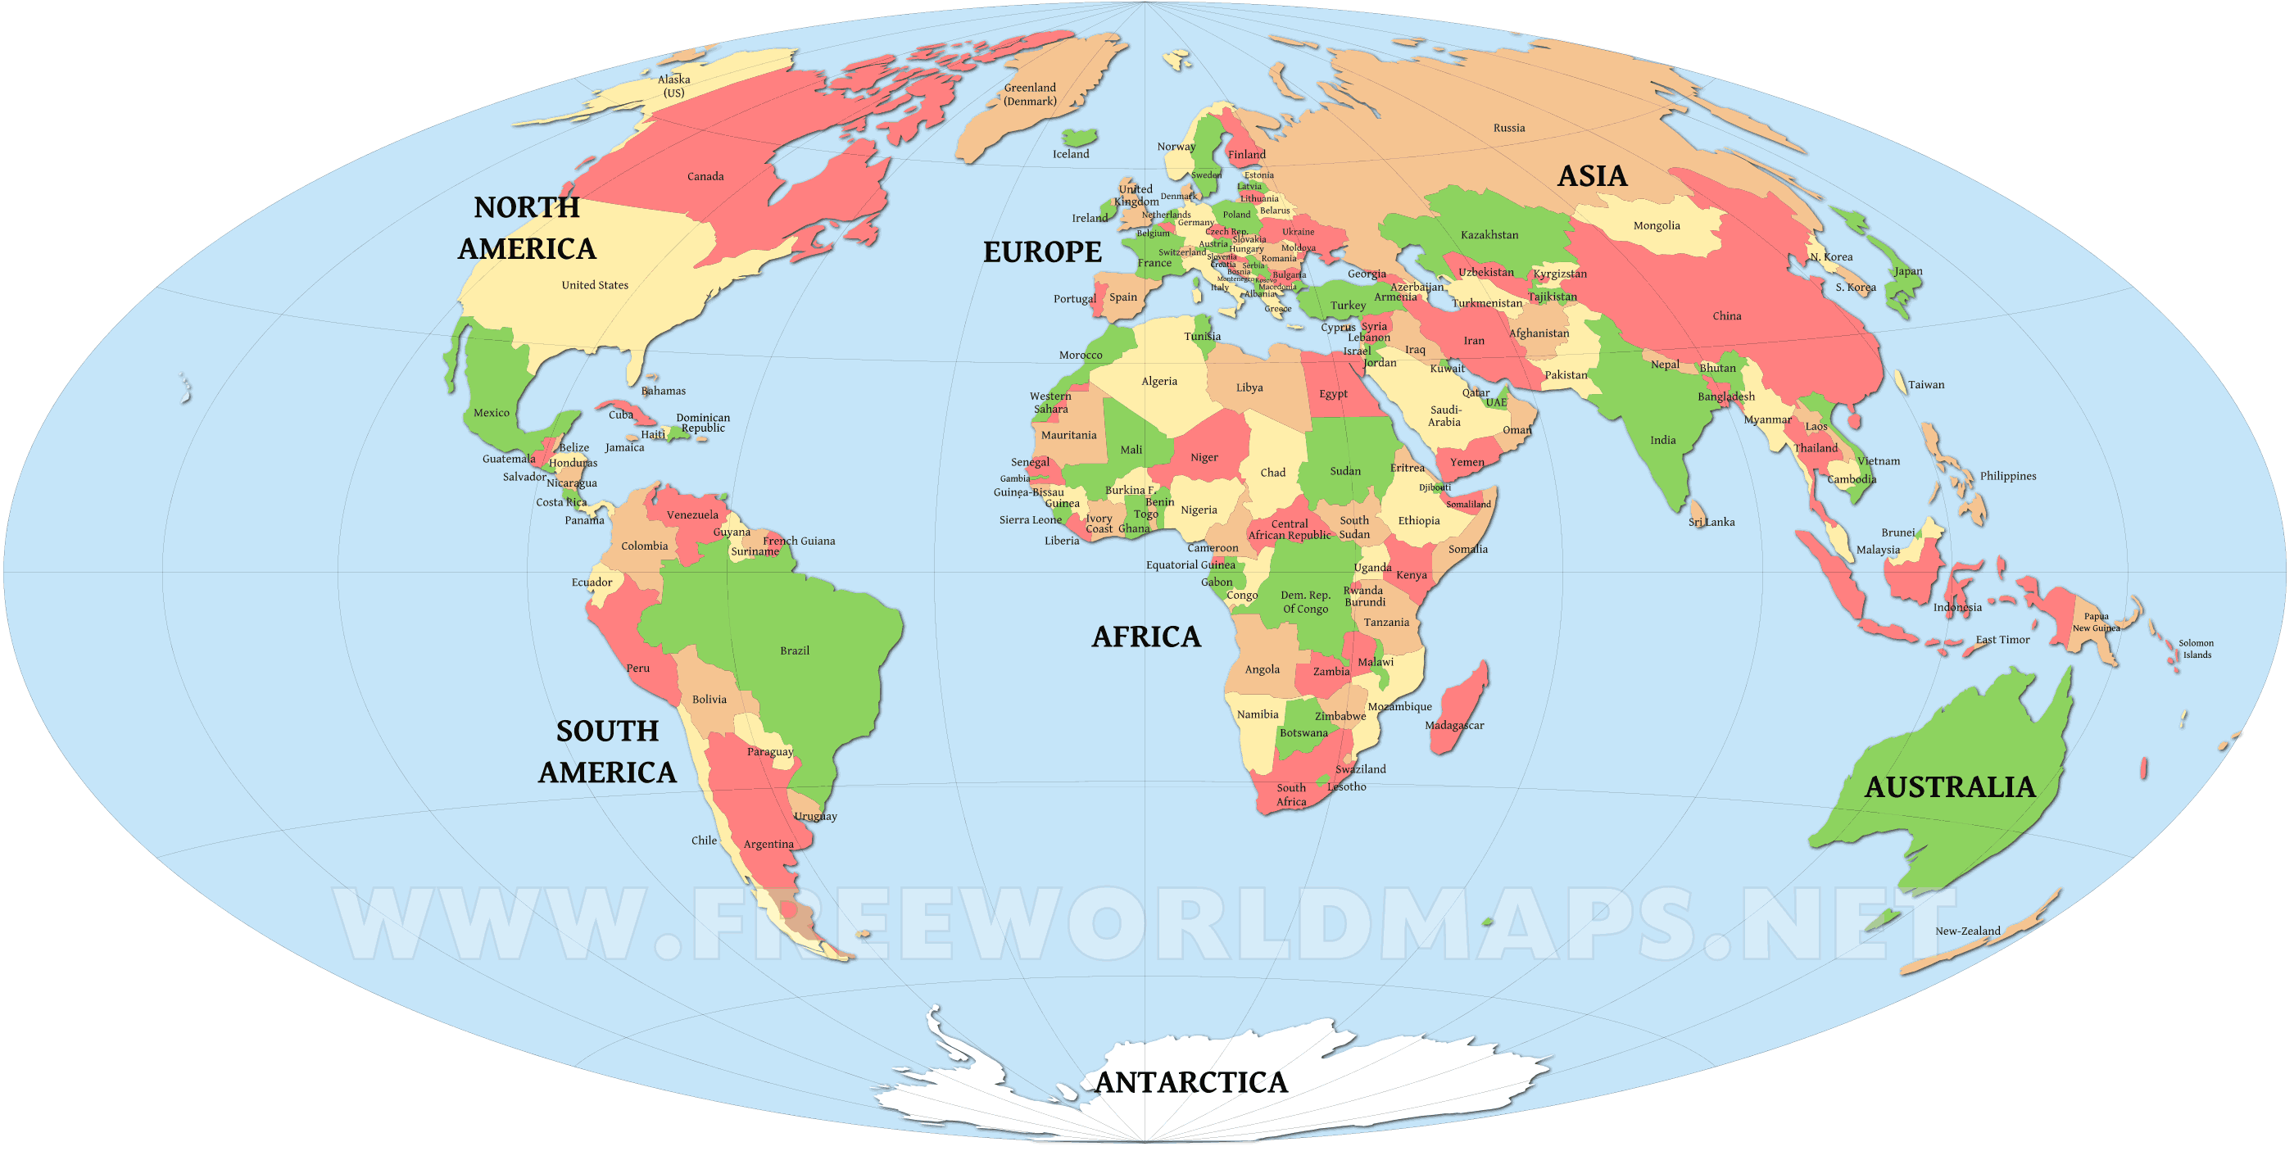
Evolutionary Theory
Naturally from a family
Into a clan
Into a tribe
Into State

Slide 6
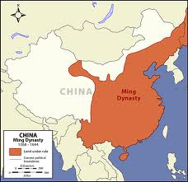
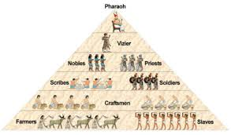
Divine Right Theory
Halo
Accepted 15th-18th centuries
God created the state
Gave divine right (Remember World History ☺)
-

Slide 7
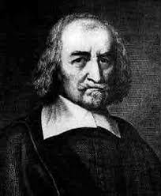
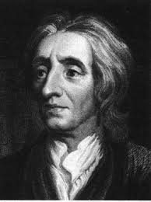
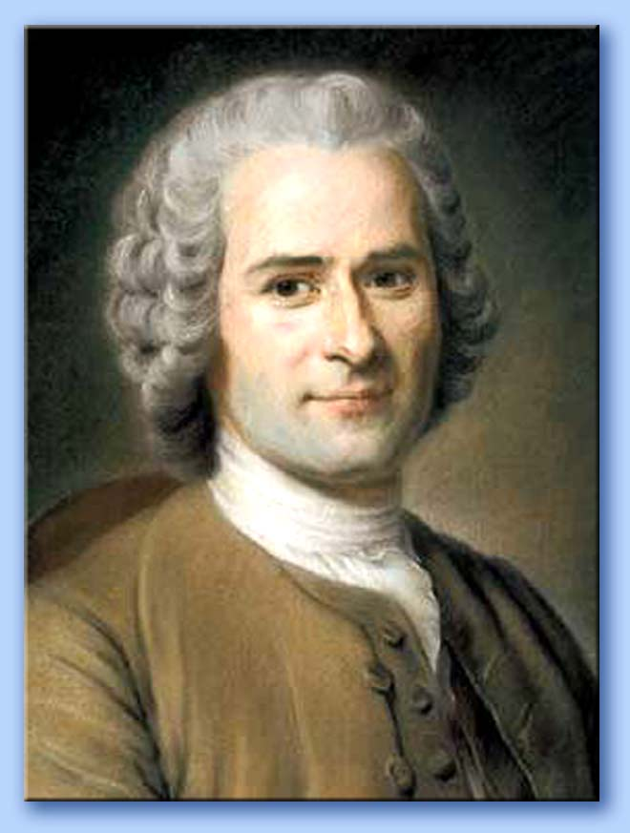
Social Contract Theory
Developed in 17th & 18th Centuries
HOBBES LOCKE ROUSSEAU
State exists to serve the people! “Sign a contract.”
People are good
Contract with each other
Society corrupts
People are bad
Contract with leader
Can’t remove
People are good
Contract with leader
Can remove

