Slide 1
Abraham Lincoln’s Assassination April 14, 1865

Slide 2
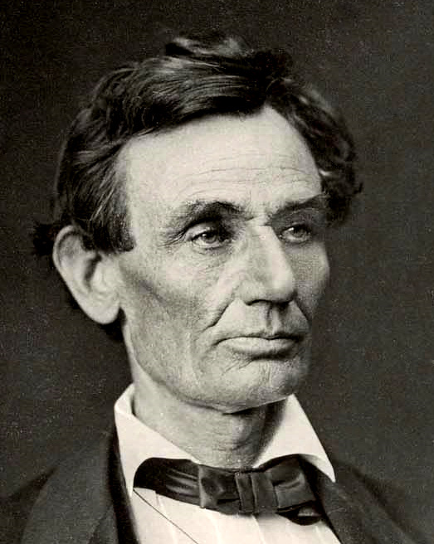
1861
1865

Slide 3
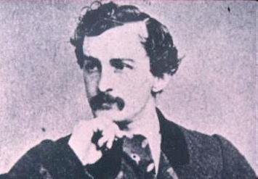
John Wilkes Booth

Slide 4
Lincoln’s Assassination
John Wilkes Booth and his group first planned to kidnap Lincoln and exchange him for Confederate POW’s
Why would this no longer work?
Booth and his group decided to assassinate Lincoln, VP Johnson, Grant, and Sec of State Seward
Johnson was not touched, Grant was out of town, and Seward was injured

Slide 5
Lincoln’s Assassination
Booth went to Ford’s Theatre in Wash DC and killed Lincoln
Booth was an actor (how did this help him?)
Booth jumps off balcony and breaks leg
Booth is found 12 days later in Virginia and is shot and killed

Slide 6
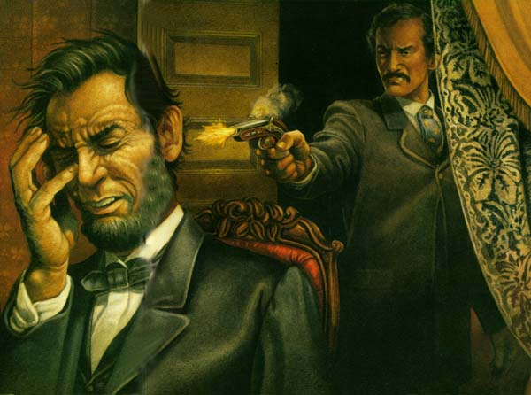

Slide 7
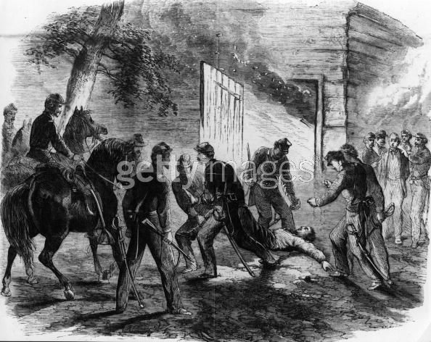

Slide 8
Who would have wanted Lincoln dead?
What is a conspiracy theory?

Slide 9
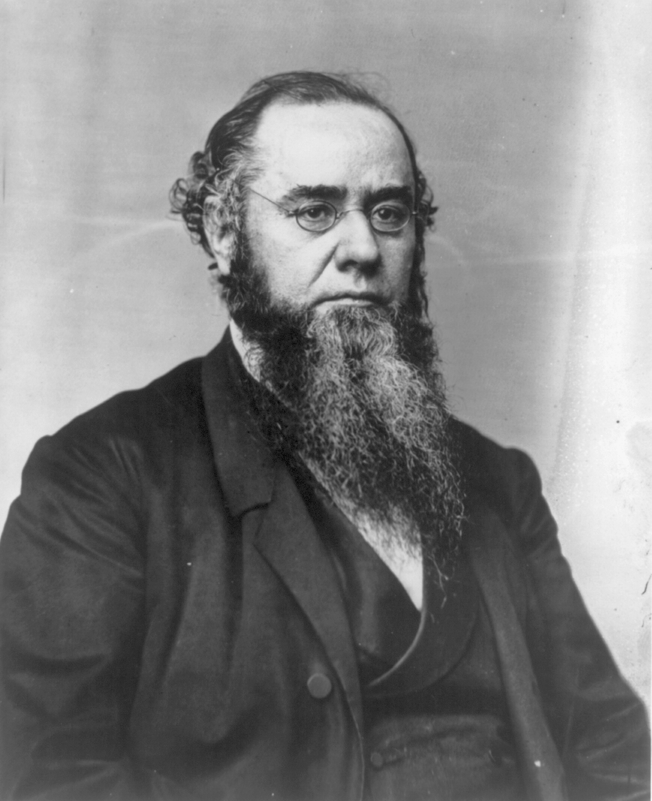
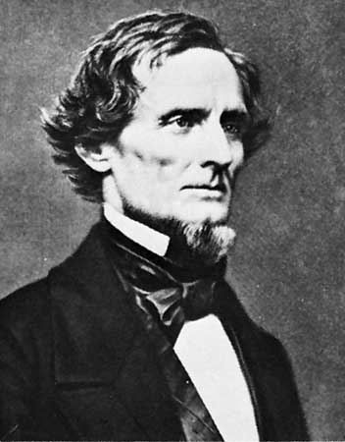
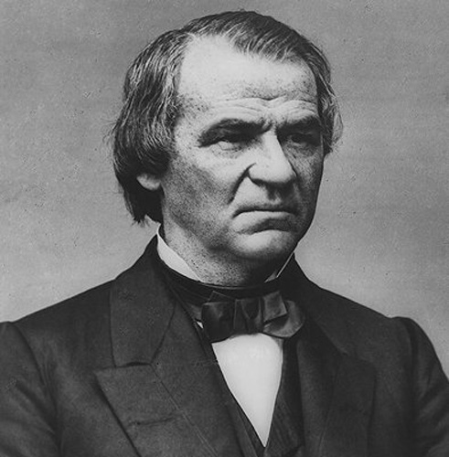
Conspiracy Theories http://rogerjnorton.com/Lincoln74.html
Confederate Leaders
Secretary of War Edwin Stanton (guard, Grant)
Andrew Johnson
International Bankers
Roman Catholic Church
Radical Republicans in the North

Slide 10
After Lincoln’s Assassination

