Slide 1
Congressional Duties, Styles, Pay
Senate & House of Representatives

Slide 2
5 Duties
Legislator
Committee Member
Representative of constituents (the people)
Servants of constituents
Politicians

Slide 3
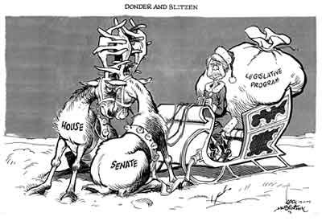
Legislator
Create Bills
Vote on Bills

Slide 4
Committee Members
1) Screen the proposals –
“Clean things up” & decide what moves forward
2) Oversight function
*Keep tabs on executive branch*
Congress sets the rules, Executive Branch needs to follow them

Slide 5
Represent Constituents
Trustees (Conscience & Judgment)
Delegates (What do “the folks back home” want me to do)
Partisans (Allegiance to what their party wants)
Politicos (Combo Plan) personal views, country views, pressure at the moment, etc.
Activity: With a partner apply the four options to a law that brings back the draft.

Slide 6
Servants of Constituents
FAVORS FAVORS FAVORS! See page 251

Slide 7
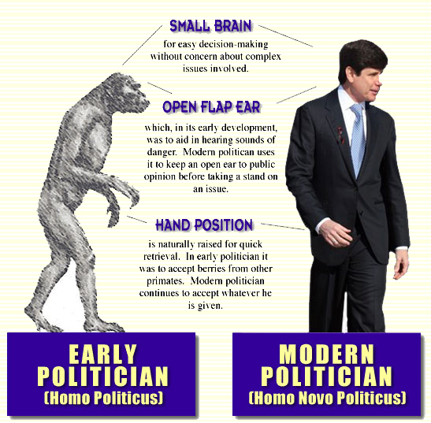
Politicians
Get reelected from voters in their district

Slide 8
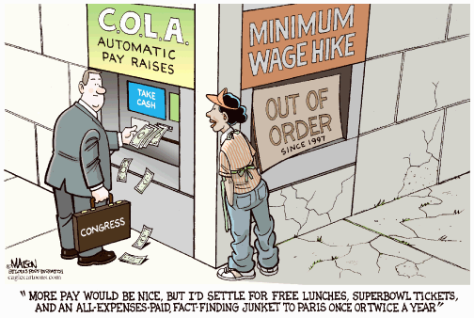
Pay!
How much do you think?
$174,000
(Too much? Too Little?)
Fringe Benefits
Immunity, Tax deduction on 2nd house, cheap health and life insurance, free office and staff H: $400,000 S: $700,000, free research at Library of Congress, printing & distribution of materials, Pension up to $150,000 per year

Slide 9
Privileges
“shall, in all cases, except treason, felony, and breach of the peace, be privileged from arrest during their attendance at the session of their respective Houses, and in going to, and returning from, the same…”
“… for any speech or debate in either House, they shall not be questioned in any other place.” Place refers to the courts.
Activity: With a partner Rank the 5 duties. Lawmaking is probably the most important. What is 2nd most important to you? Least important? Why?

