Slide 1
Conflict with Native Americans
5-2

Slide 2
Reservations
Some resisted
Others sold land
Many massacred

Slide 3
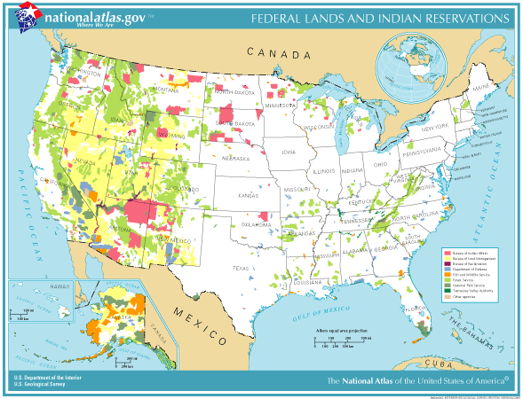

Slide 4
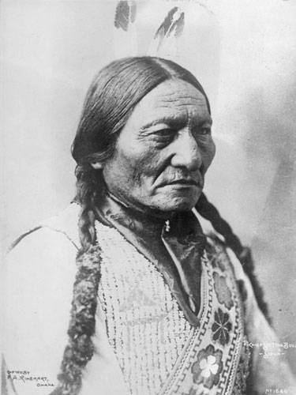
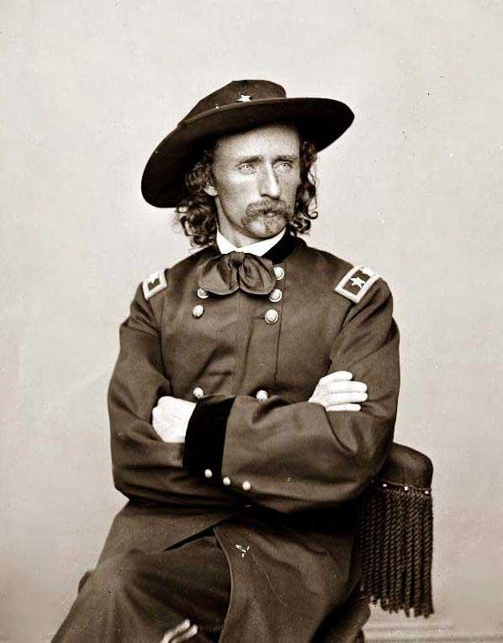
Sioux Uprising
Gold in South Dakota
Sitting Bull and others left the reservation
Gen. George Custer sent out
Battle of Little Big Horn
Custer and 200 Killed
1890 Wounded Knee
U.S. massacred 200 unarmed Sioux (women and children as well)

Slide 5
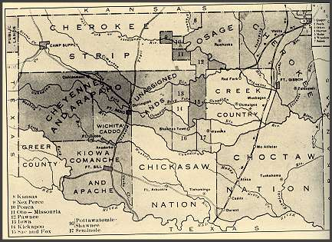
Culture Destroyed
Dawes Act
Gave bad land to Natives families who wanted to farm
Boomers and Sooners
Noon April 22, 1889
2 Million free acres for homesteads
***Video Clip from Far and Away “Land Rush”

