Slide 1
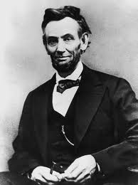
Election of 1864

Slide 2
Election of 1864
Why did Lincoln think he would lose?
What has helped his chances of being reelected? What has hurt his chances?
Why did the South not want Lincoln to win?

Slide 3
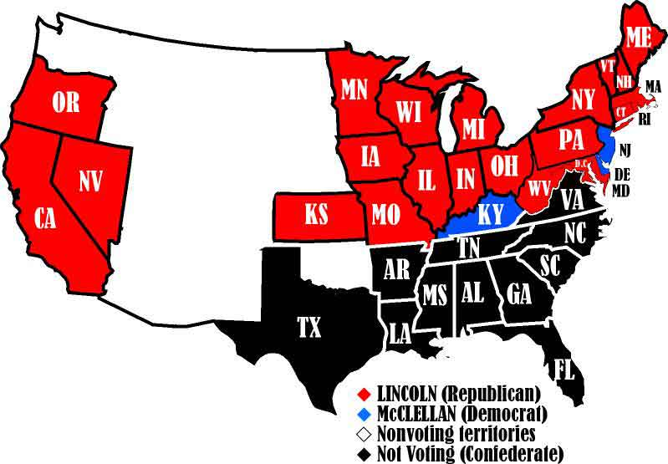
Election of 1864 Results

