Slide 1
Westward Expansion
5-1

Slide 2
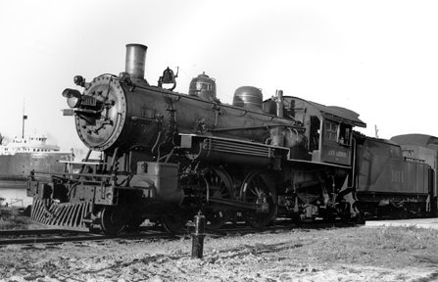
Settling the Land
Manifest Destiny
Railroads get free land
10 square miles
Federal Govt→State Govt→Land Speculators

Slide 3
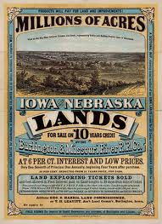

Slide 4
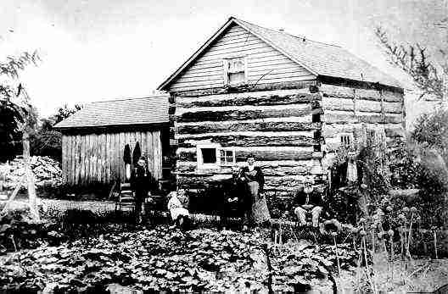
Homestead Act
1862 FREE LAND! 160 Acres
Catch?
21 years old
U.S. Citizens or have applied
$10 Registration fee
Build a house and live there
Needed to stay for 5 years

Slide 5
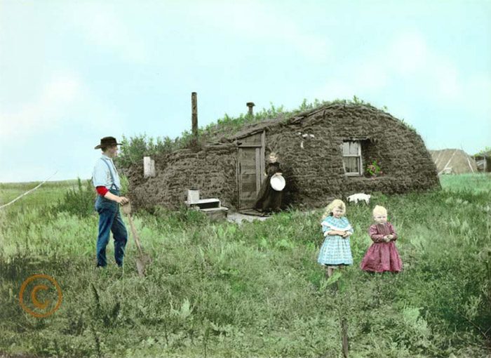
Problems
Mostly alone
Few towns
Some didn’t know how to farm
Men had to leave/women were alone
Squatters- people that settled on land that wasn’t theirs

