Slide 1
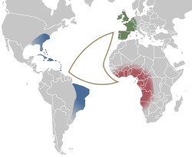
The Middle Passage
The most infamous route of the Triangle Trade

Slide 2
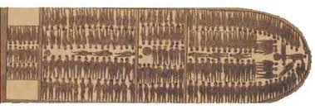
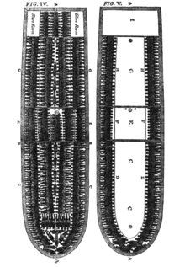
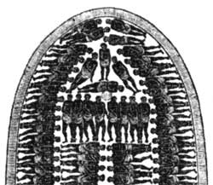
Seating Arrangements on the ships

Slide 3
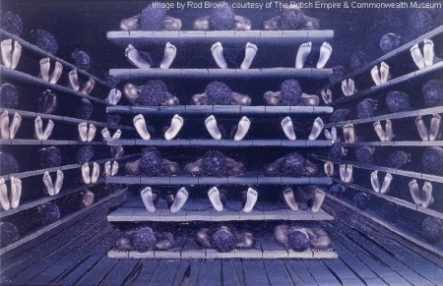
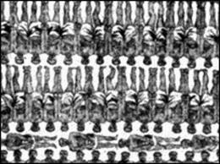
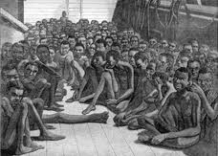
This is how they had to be position to fit
the large amount of African Americans
forced as slaves on the ships.
3,700 mile voyage to The Americas.
454 Slaves
6ft by 1 ft 4in for each man
5ft 10in by 1 ft 4in for each woman
5ft by 1ft 2in for each boy

Slide 4
Daily Routine on Slave Ships
A. If there was good weather, slaves were brought up on deck in the morning.
1. Women/children would roam around deck.
2. Men had to keep in shape before reaching main destination.
B. 9am morning meal with half pint of water in a small pan.
1. All different meals for areas on the ship (examples- boiled rice and cornmeal, stewed yams, and starchy manioc and banana like fruits. Sometimes meat was given).
C. Late afternoon, second and ONLY other meal of the day.
1. Sometimes same as first meal.
2. Most time horse beans (large beans used to feed horses)
a. Why? ----> Cheap
b. Would pour red pepper on the mix of steamed horse beans in either oil, flour, or water (Called it “Slobber sauce”).

Slide 5
D. Must keep fit
1. Why?---> Be sold at the highest price.
2. Had to “dance” on deck
a. Shackled together and forced to jump up and down until they had raw/bloody ankles. (Used whips if “needed”).
3. Women and children could dance to the rhythm.
E. At sunset, slaves were placed back below the deck to rest in misery and filth.

Slide 6
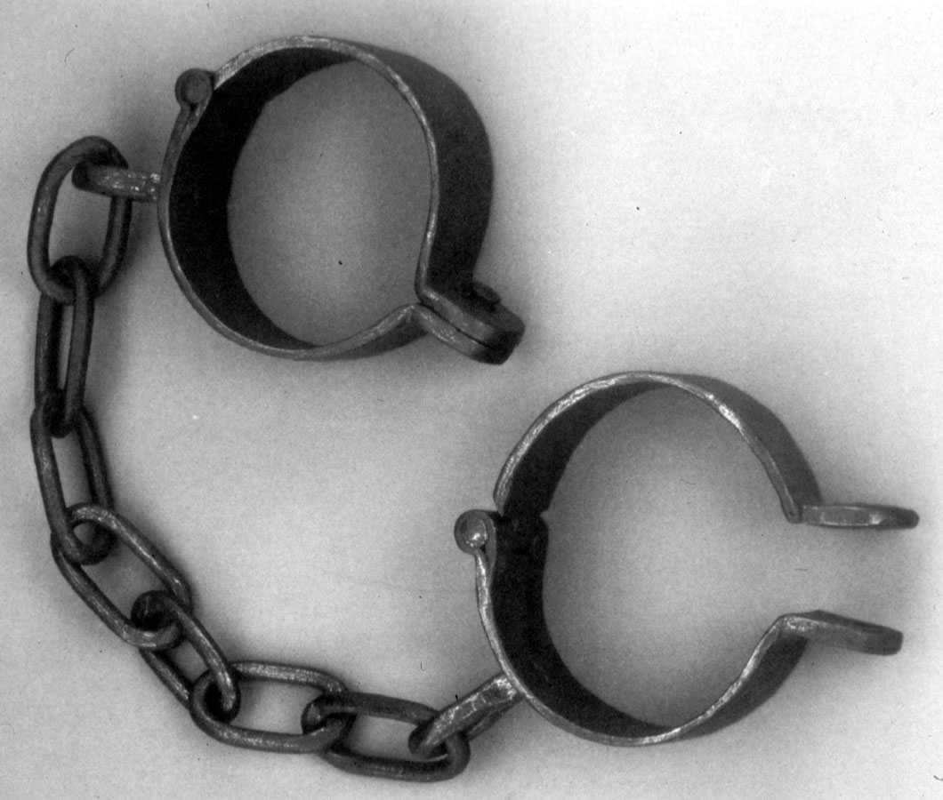
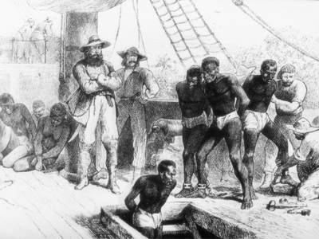
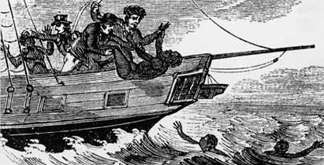
Some Slaves
revolted by:
Escaping
Jumping overboard
Refusing to eat

Slide 7
Between Decks
1.During bad storms, slaves stayed below all day and night.
2. Not just slaves, but living and dead…
3. Blood, vomit, urine and human waste below the decks.
4. Sometimes not fed during bad weather.
5. Slave women beaten and abused.
6. Rarely clean (Look back at number 3).

Slide 8
Before Getting to The Americas
Fed better days before arrival to The New World.
Before being sold, slaves were oiled to make skin shiny, hide imperfections (scars from whips) and have scars filled in with hot tar (would improve the appearances of the slaves and help get better prices for the slave traders).
Couldn’t dock due to fear of diseases and horrible smell.
Anchored ships miles away and slaves were put onto small boats.
Sold at an auction and served their owners.

Slide 9
Effects of The Middle Passage
Remains today as the paramount example of human mistreatment and suffering.
Africans were: Captured…Branded…Locked in chains….and Humiliated… Everything stripped away by slavery…
Shows horror of slavery that occurred during The Middle Passage.

