Slide 1
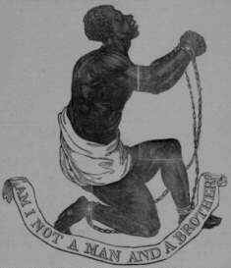
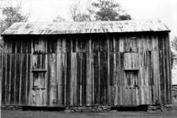
Slavery or Freedom in West

Slide 2
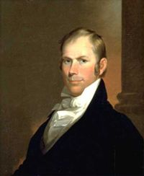
Missouri
Missouri Compromise
Missouri wanted to enter as a slave state
Give the south more votes
North upset
Henry Clay came up w/ Missouri Compromise
Add Maine as free, Missouri as slave
12 vs. 12
Henry Clay

Slide 3
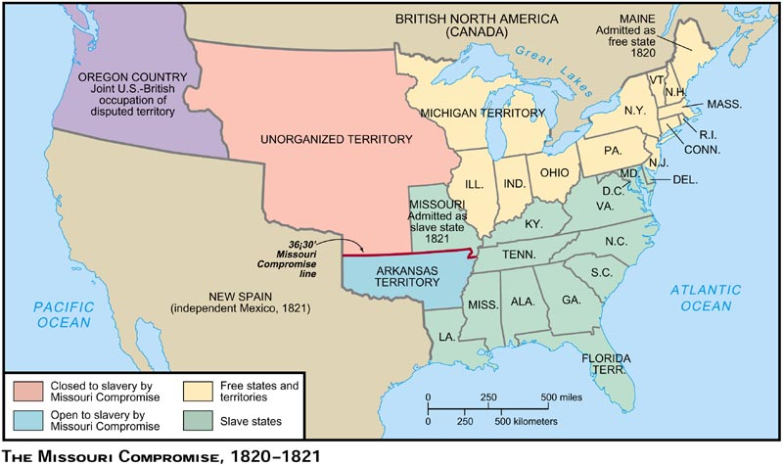

Slide 4
Mexican Cession
Sectionalism: Loyalty to state or section
North wanted slavery to end
South wanted slavery to continue
Major problem for new states
Popular Sovereignty: choice by the people living there

Slide 5
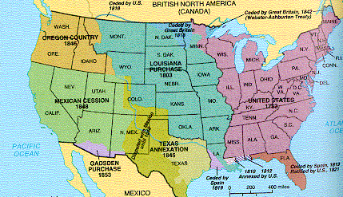

Slide 6
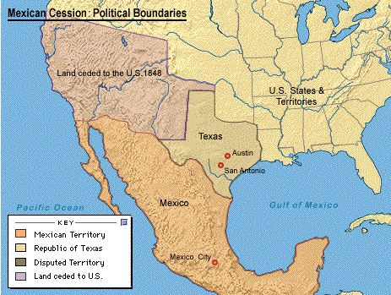

Slide 7
Antislavery Parties Meet
Whigs and Democrats wanted slavery to end
Neither wanted to lose votes
Founded “Free Soil Party”
Wanted to keep slavery out of the west
However, few were abolitionists

