Slide 1
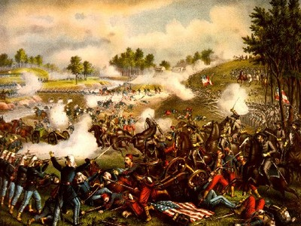
First Battle of Bull Run
July 1861

Slide 2
Battle of Bull Run
Some thought the war would last 90 days (why?)
North wanted to capture the Confederate capital of Richmond, VA
South sent soldiers to stop the Union
Many civilians and reporters followed Union soldiers (why?, problems with this?)

Slide 3
Battle of Bull Run
Confederate Colonel “Stonewall” Jackson given his nickname here
Confederates win the battle as Union was unprepared and overconfident
Proved it was going to be a LONG war

