Slide 1
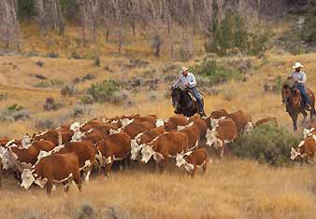
Ranching etc.

Slide 2
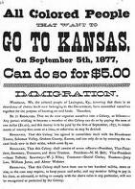
Farms & Ranches
Dry Farming
-Crops needing little rain
Bonanza Farms
Large corporations
The Grange
Helped farmers form cooperatives
Exodusters
Morrill Land-Grant Act
Stats and info.

Slide 3
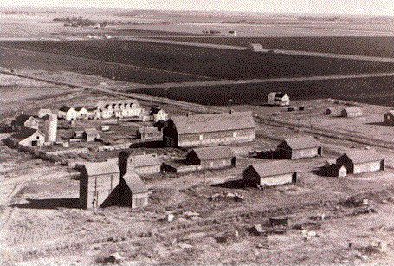
Bonanza Farm

Slide 4
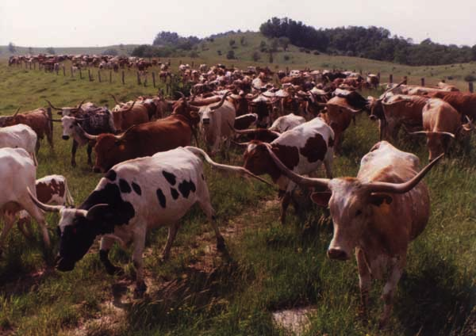
Fence?
Long Drives
Cowboys
Fencing territory
Changed things

Slide 5
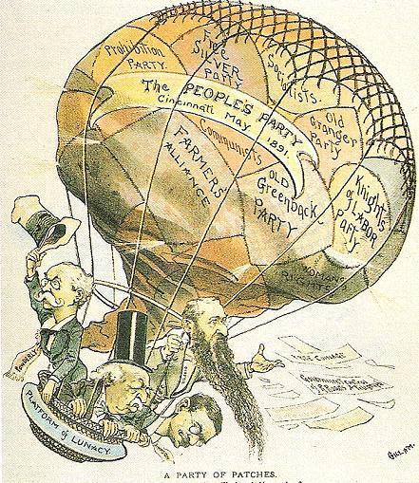
$$$
Tariffs
Populists (Political Group)
Silver circulation
Progressive income tax
8 hr day

