Slide 1
Ch. 3 Europeans Reach the Americas
I. The Middle Ages
A. Feudal System
1. King/Queen
2. Nobles/Lords
3. Serfs/Peasants
4. Manors: lord’s castle, peasants’ huts &
surrounding villages or fields.
5. People had to be self-sufficient.
6. All Christians in W. Europe belonged to the
Roman Catholic Church.

Slide 2
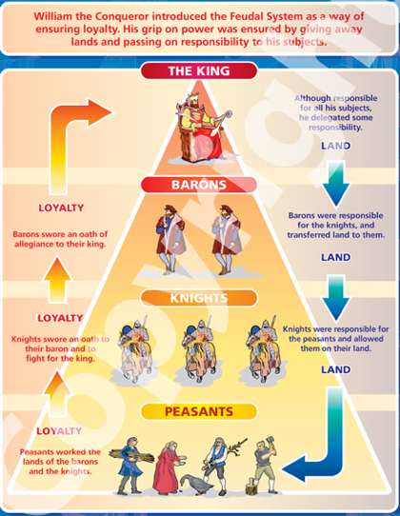
The Feudal System

Slide 3
B. A Changing Europe
1. The Crusades
a. Jerusalem - sacred; Jesus lived & taught
there - Holy Land.
b. Jerusalem was also holy to Jews and Muslims.
c. From 1100-1300, Christians and Muslims
fought for control of the Holy Land.
d. Europeans lost wars; traveled beyond
small towns of birth.
e. Trade began with Arab merchants from the
Middle East.

Slide 4
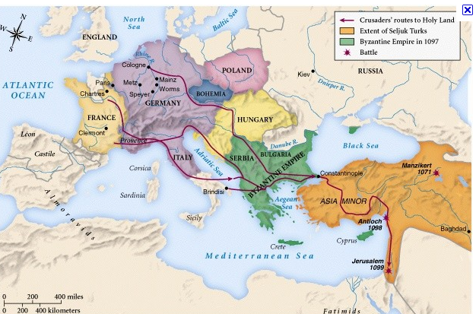
The First Crusade

Slide 5
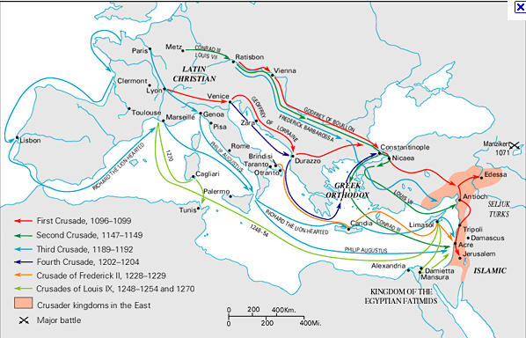
The Four Crusades

Slide 6
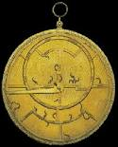
2. Navigation Technology
a. Magnetic compass - sail straight
b. Astrolabe - position of stars
and figure latitude at sea.
3. A Revival of Learning
a. Translations of Greek, Roman, & Arab.
b. Renaissance - Rebirth: 1300’s - 1600.
c. Printing Press - Johannes Gutenberg

Slide 7
C. Search for New Trade Routes
1. Monarchs fought to increase power.
2. Spain, England, France, Portugal - all looked
for ways to increase wealth.
3. Prince Henry - Portugal; sail south along west
coast of Africa.
a. Caravel - ship with triangular sails & rudder
4. Bartholomeau Dias- P.; reached southern tip of
Africa.
5. Vasco da Gamma- P; around Africa to India

Slide 8
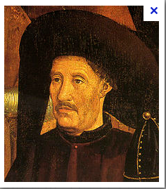
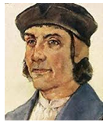
Prince Henry
Bartholomeu Dias
Vasco Da Gamma

Slide 9
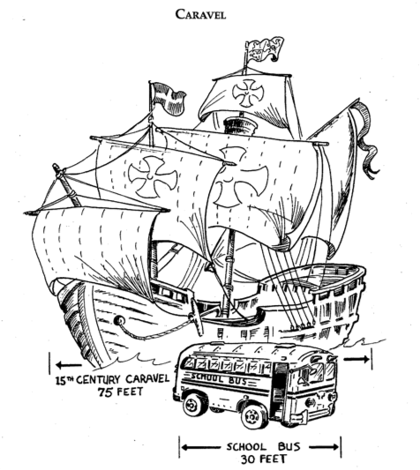

Slide 11
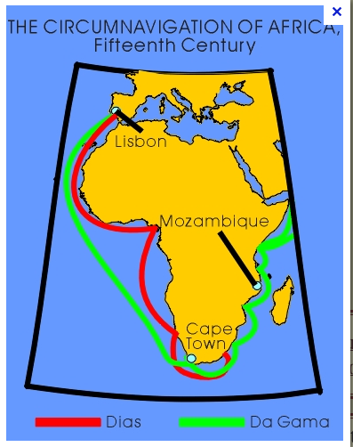
Dias/ Da Gamma
Routes

Slide 12
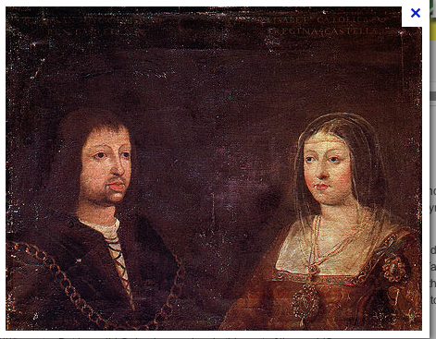
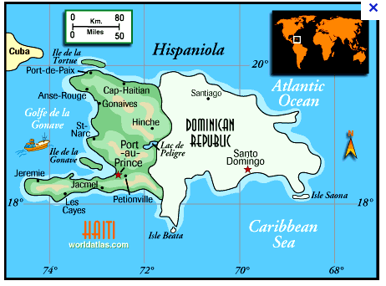
King Ferninand
And Queen Isabella
D. Columbus Reaches the Americas
1. King Ferdinand & Queen Isabella - Spain
2. He was headed to the East Indies.
3. August 1492, 3 ships: Santa Maria, Nina, Pinta
and 90 sailors.
4. Oct. saw birds flying southwest; changed route.
5. Oct. 12 spotted white cliffs - LAND!
6. Tainos - West Indies
7. Gold, pink pearls, colored parrots, tobacco,
pineapples, & hammocks.
8. “Admiral of the Ocean Sea”
9. Three more voyages
10. Hispaniola - first Spanish colony
11. Native Americans - wiped out in about 100
years.
Hispaniola

Slide 13
