Slide 1
America at War
1917

Slide 2
Need for Men
Sent money and supplies
200,000-300,000,000 (How?)
Selective Service Act- AKA: Draft
24 million registered (Why?)
War to end all wars!
Volunteers and Nat. guard were (AEF: American Expeditionary Force)

Slide 3
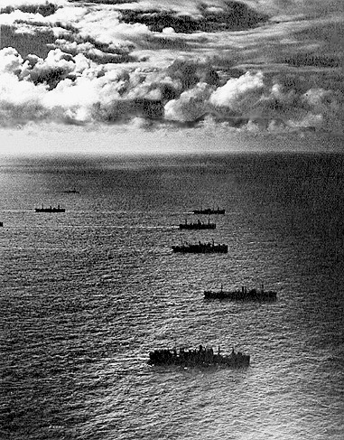
Strategy
Convoy- Protecting supplies
Liberty Bonds $$$$
Rationing
Food & fuel
Daylight Savings Time
Prohibition (18th amendment)
Women
Loyalty promotion

Slide 4
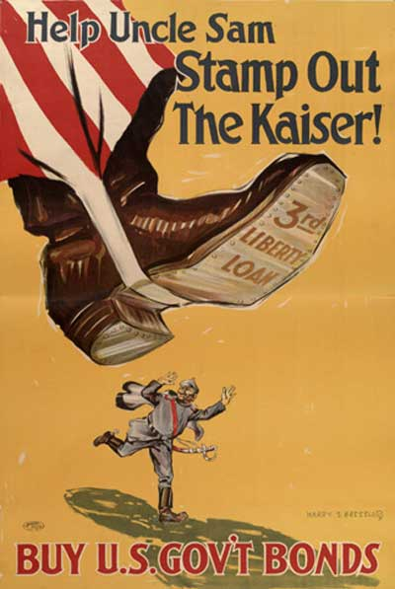

Slide 5
