Slide 1
Political Parties
5 Functions

Slide 2
List
Nominating
Informer-Stimulator
The “Seal of Approval”
Governmental
Watchdog

Slide 3
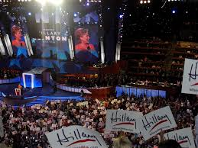
Nominating
Most important function
Find, recruit, choose
Analogies: colleges, jobs

Slide 4
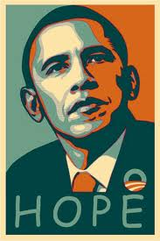
Informer-Stimulator
Getting people jacked up!!
“Educating” people
How do parties do this? Types of propaganda?

Slide 5
“Seal of Approval”
A type of background check
QUALIFIED & GOOD CHARACTER

Slide 6
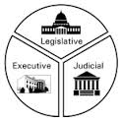
Governmental
“Government by Party”
Mostly done on a partisan basis
Power of appointment
Reshaping of constitutions through amendments
How does separation of powers affect political parties and their governmental function?

Slide 7
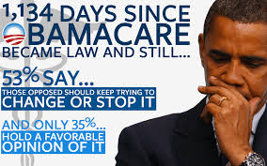
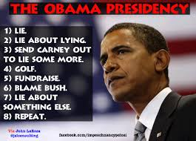
Watchdog
The party out of power
Criticize criticize criticize until people believe
“Throw them out!”
Current examples? True or False? Or little fibs?

Slide 8
